Slide 1
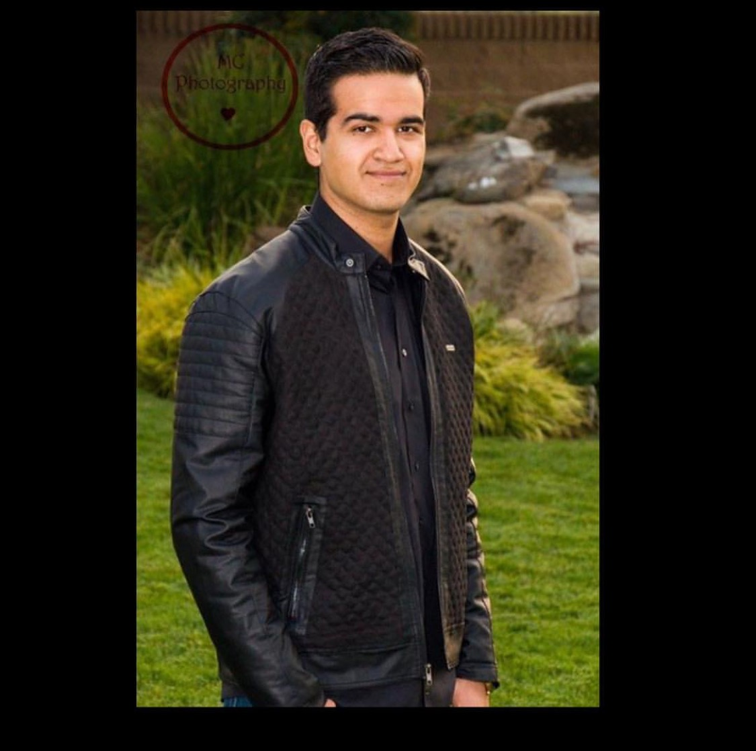
Sergio Najera
Class of 2107

Slide 2
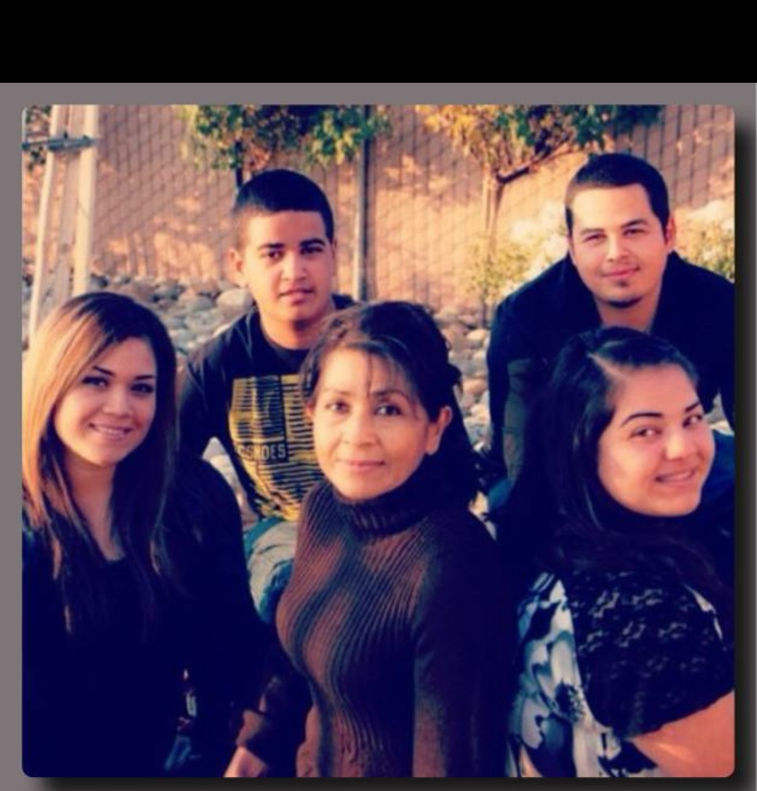
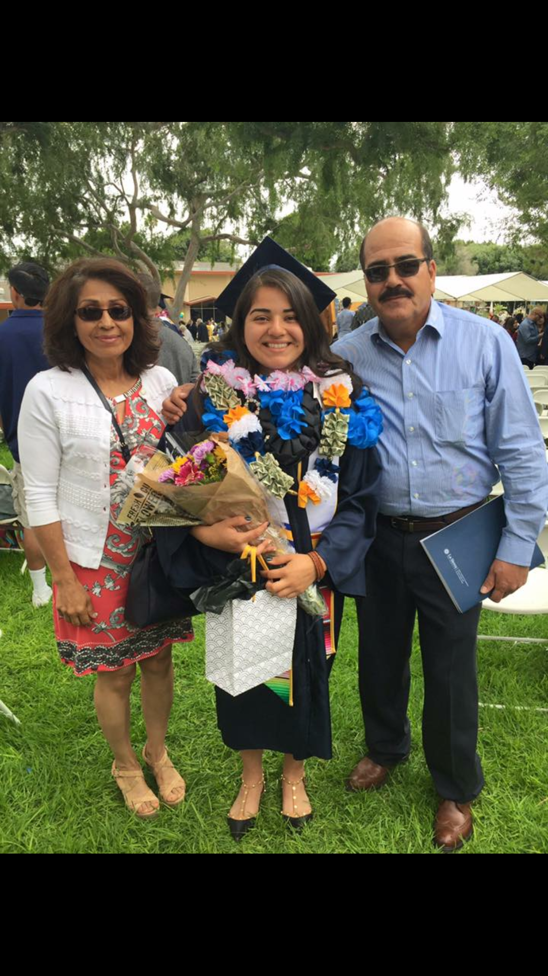
ABOUT ME
I from a family of 4
The son of Santos and Sylvia Najera
The youngest of my family
I was born in Lindsay CA
Will be the second to go to college

Slide 3
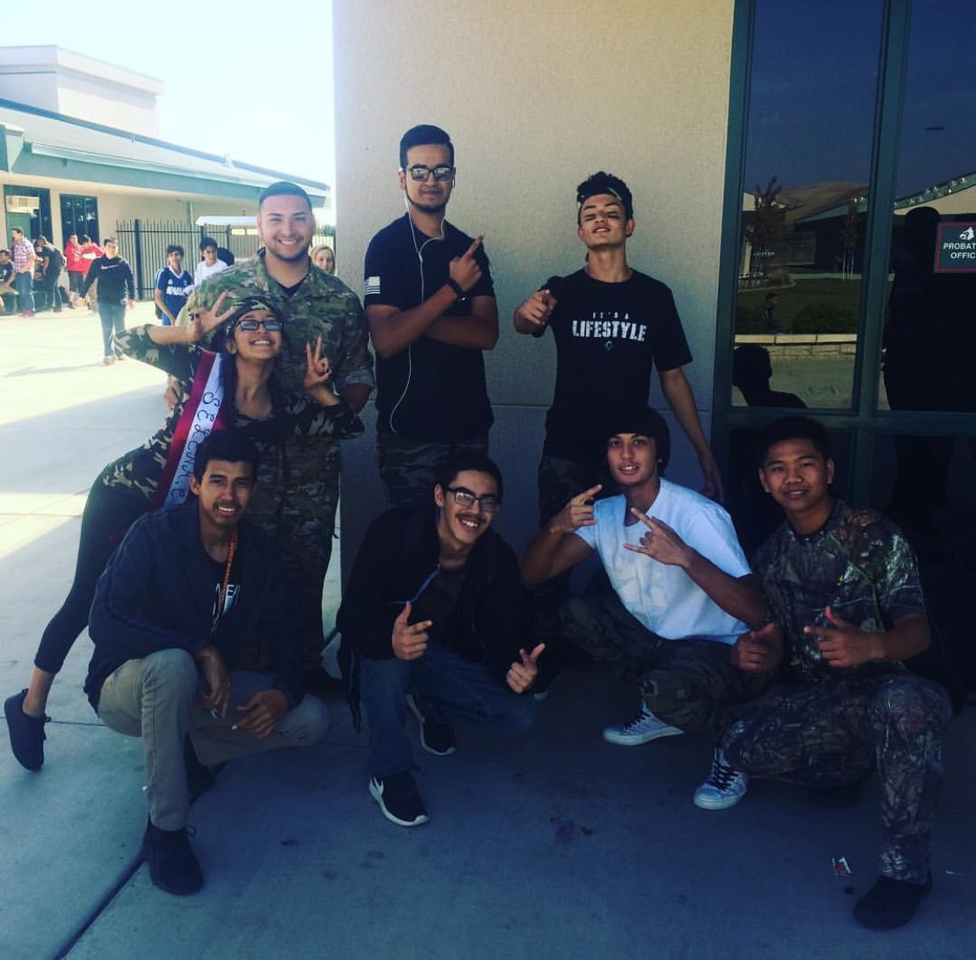
High School Experiences
Challenges
Class schedule
Staying on pace
What I've learned
Stay organized
Be responsible
Love being involved with school activities
Ralleys
Games /Class activities

Slide 4
Job Shadow
Edward Castro
Works at Kaweah delta
Taught me step by step

Slide 5
Pathway
Computer sciences
Has taught me a lot on computers
Business

Slide 6
Plans after High School
Porterville college
Apply to UC Riverside
Major in Computer Programming and Engineering
Start my career

Slide 7
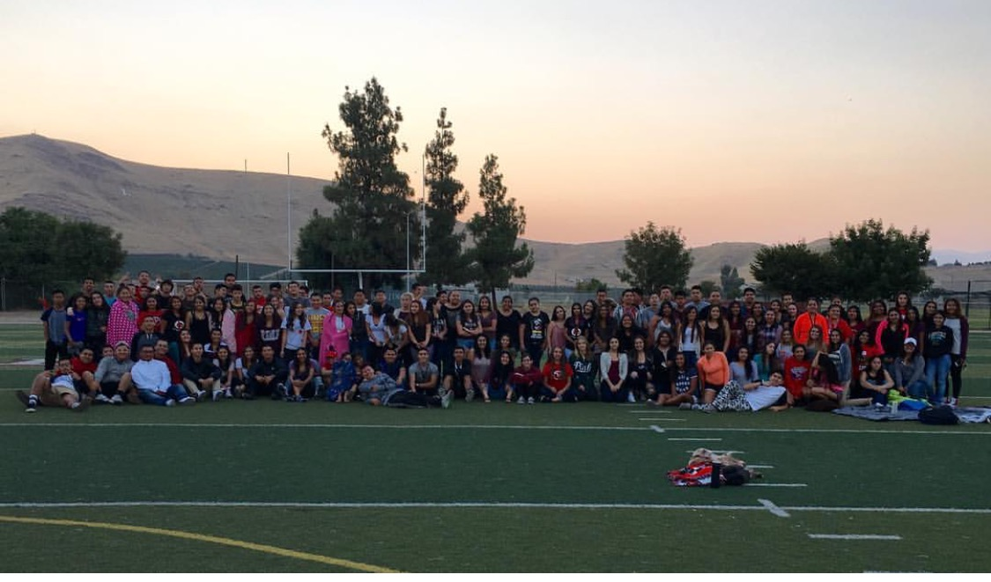
Leaving High School
Lessons learned
Grateful for teachers/students that help me
Will miss everybody and everything

